Slide 1
Deep subspace clustering networks
Pradeepti Garg Rahul Kumar
2016A3PS0205P 2016A3PS0223P

Slide 2
Introduction
The paper presents a deep neural network architecture for unsupervised subspace clustering. This architecture is built upon deep auto-encoders, which non-linearly
map the input data into a latent space. The key idea is to introduce a novel self-
expressive layer between the encoder and the decoder to mimic the “self expressiveness” property that has proven effective in traditional subspace clustering.
We used keras to implement the autoencoder layers and and ran the training of google colaboratory.

Slide 3
Self Expressiveness
Expressing a point in a subspace as a linear combination of other points in the same subspace. If we stack all the points X[i] into columns of data matrix X, we can represent the self expressive property by 1 single equation i.e.
X= XC
where C is a self representation coefficient matrix.
We can later formalize this idea as a mathematical problem
min||C||ₚ, such that X=XC, (diag(C)==0),

Slide 4
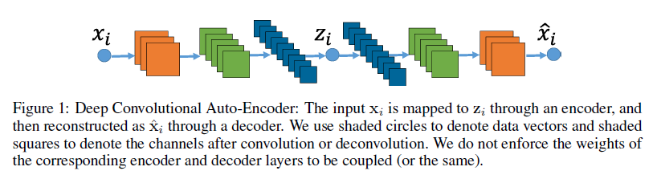
Self Expressive layer in deep autoencoders

Slide 5
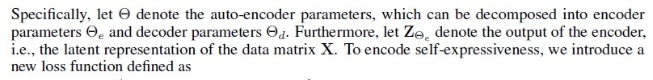
Our goal is to train a deep auto-encoder, such as the one depicted by Figure , such that its latent representation is well-suited to subspace clustering. To this end, we introduce a new layer that encodes the notion of self-expressiveness. Specifically, let denote the auto-encoder parameters, which can be decomposed into encoder parameters e and decoder parameters d.

Slide 6
Autoencoders
Autoencoders = encoder+ decoder
Autoencoders can non linearly transform data in latent space. If the dimension of latent space is lower than we can think of it as like non linear PCA.
We used autoencoders with different layers and channel size for different data sets. For ex Extended Yale B, ORL , COIL20 and COIL100.

Slide 7
Network Architecture
Our network consists of three parts. A stacked encoder, a self expressive layer and a stacked decoder. We are focusing on image clustering problem and hence we have used convolutional autoencoders as they have lower parameters to train.
We used kernels with stride 2 in both horiontal and vertical direction ,and the Relu function.

Slide 8
Training Strategy
It is very difficult to train a network with a million of parameters from scratch.
To address we use the pretraining and fine tuning strategies described below.
Pretraining
We first pre train the deep autoencoder without self expressive layer on the all the data we have. We then use the trained parameters to initialize the encoder and decoder layers of our network.

Slide 9
Experiment
We implemented our method in python using keras 2.0.
Extended Yale B Dataset
conv1 = Conv2D(10, (5, 5), activation='relu', padding='same')(input_img) #42 x 42 x 10
pool1 = MaxPooling2D(pool_size=(2, 2))(conv1) #21 x 21 x 10
conv2 = Conv2D(20, (3, 3), activation='relu', padding='same')(pool1) #21 x 21 x 20
pool2 = MaxPooling2D(pool_size=(2, 2))(conv2) #10 x 10 x 20
conv3 = Conv2D(30, (3, 3), activation='relu', padding='same')(pool2) #7 x 7 x 30 (small and thick)
#decoder
conv4 = Conv2D(30, (3, 3), activation='relu', padding='same')(conv3) #10 x 10 x 30
up1 = UpSampling2D((2,2))(conv4) # 20 x 20 x 30
conv5 = Conv2D(20, (3, 3), activation='relu', padding='same')(up1) # 20 x 20 x 20
up2 = UpSampling2D((2,2))(conv5) # 40 x 40 x 20
decoded = Conv2D(10, (5, 5), activation='relu', padding='same')(up2) # 40 x 40 x 10

Slide 10
ORL DATA SET
conv1 = Conv2D(10, (5, 5), activation='relu', padding='same')(input_img) #32 x 32 x 10
pool1 = MaxPooling2D(pool_size=(2, 2))(conv1) #16 x 16 x 10
conv2 = Conv2D(20, (3, 3), activation='relu', padding='same')(pool1) #16 x 16 x 20
pool2 = MaxPooling2D(pool_size=(2, 2))(conv2) #8 x 8 x 20
conv3 = Conv2D(30, (3, 3), activation='relu', padding='same')(pool2) #8 x 8 x 30 (small and thick)
#decoder
conv4 = Conv2D(30, (3, 3), activation='relu', padding='same')(conv3) #8 x 8 x 30
up1 = UpSampling2D((2,2))(conv4) # 16 x 16 x 30
conv5 = Conv2D(20, (3, 3), activation='relu', padding='same')(up1) # 16 x 16 x 20
up2 = UpSampling2D((2,2))(conv5) # 32 x 32 x 30
decoded = Conv2D(10, (5, 5), activation='relu', padding='same')(up2) # 32 x 32 x 10

Slide 11
COIL 20
#input = 32 x 32 x 1 (wide and thin)
conv1 = Conv2D(15, (3, 3), activation='relu', padding='same')(input_img) #32 x 32 x 15
#decoder
decoded = Conv2D(15, (3, 3), activation='sigmoid', padding='same')(conv1) # 32 x 32 x 15

Slide 12
COIL 100
conv1 = Conv2D(50, (5, 5), activation='relu', padding='same')(input_img) #32 x 32 x 50
#decoder
decoded = Conv2D(50, (5, 5), activation='sigmoid', padding='same')(conv1) # 32 x 32 x 50

Slide 13
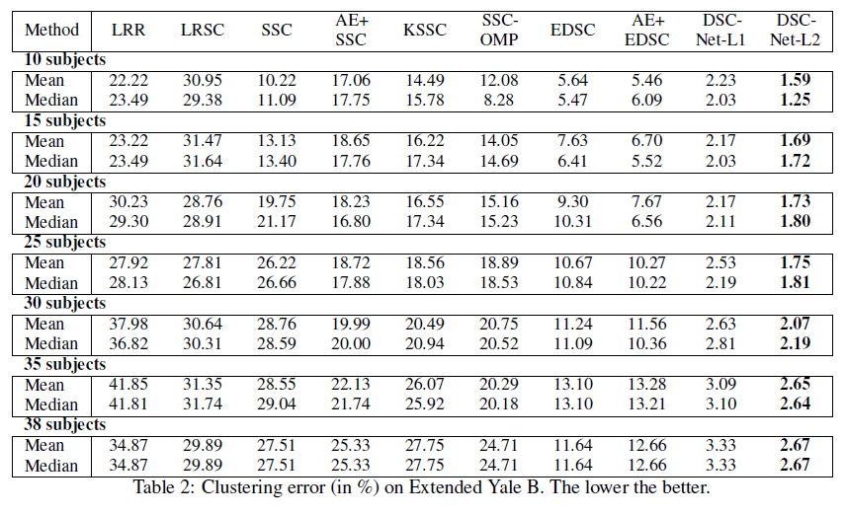
Outcome

Slide 14
BIBLIOGRAPHY
Pan Ji and Tong Zhang, Deep Subspace Clustering Networks
Ehsan Elhamifar, Rene Vidal Sparse Subspace Clustering : Algorithm, Theory, and Applications
Francois Chollet , Deep Learning with Python
Rowel Atienza, Advanced Deep Learning with Keras

